Slide 1
Software Processes

Slide 2
The software process
A structured set of activities required to develop a software system.
Many different software processes but all involve:
Specification – defining what the system should do;
Design and implementation – defining the organization of the system and implementing the system;
Validation – checking that it does what the customer wants;
Evolution – changing the system in response to changing customer needs.
A software process model is an abstract representation of a process. It presents a description of a process from some particular perspective.

Slide 3
Software process descriptions
When we describe and discuss processes, we usually talk about the activities in these processes such as specifying a data model, designing a user interface, etc. and the ordering of these activities.
Process descriptions may also include:
Products, which are the outcomes of a process activity;
Roles, which reflect the responsibilities of the people involved in the process;
Pre- and post-conditions, which are statements that are true before and after a process activity has been enacted or a product produced.

Slide 4
Plan-driven and agile processes
Plan-driven processes are processes where all of the process activities are planned in advance and progress is measured against this plan.
In agile processes, planning is incremental and it is easier to change the process to reflect changing customer requirements.
In practice, most practical processes include elements of both plan-driven and agile approaches.
There are no right or wrong software processes.

Slide 5
Process Models

Slide 6
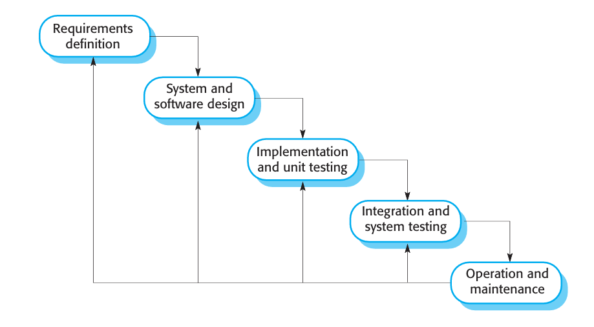
The waterfall model

Slide 7
The stages of the waterfall model
1. Requirements analysis and definition: The system’s services, constraints, and goals are established by consultation with system users. They are then defined in detail and serve as a system specification.
2. System and software design: The systems design process allocates the requirements to either hardware or software systems. It establishes an overall system architecture. Software design involves identifying and describing the fundamental software system abstractions and their relationships.
3. Implementation and unit testing: During this stage, the software design is realized as a set of programs or program units. Unit testing involves verifying that each unit meets its specification.

Slide 8
4. Integration and system testing: The individual program units or programs are integrated and tested as a complete system to ensure that the software requirements have been met. After testing, the software system is delivered to the customer.
5. Operation and maintenance: Normally, this is the longest life-cycle phase. The system is installed and put into practical use. Maintenance involves correcting errors that were not discovered in earlier stages of the life cycle, improving the implementation of system units, and enhancing the system’s services as new requirements are discovered.

Slide 9
Waterfall model phases
The result of each phase in the waterfall model is one or more documents that are approved (“signed off”).
The following phase should not start until the previous phase has finished.
The main drawback ?

Slide 10
Drawback?
The main drawback of the waterfall model is the difficulty of accommodating change after the process is underway.
Inflexible partitioning of the project into distinct stages makes it difficult to respond to changing customer requirements
In principle, a phase has to be complete before moving onto the next phase.
Costly

Slide 11
Waterfall model applications
Therefore, this model is only appropriate when the requirements are well-understood and changes will be fairly limited during the design process.
Few business systems have stable requirements.
1. Embedded systems.
2. Critical systems
3. Large software systems

Slide 12
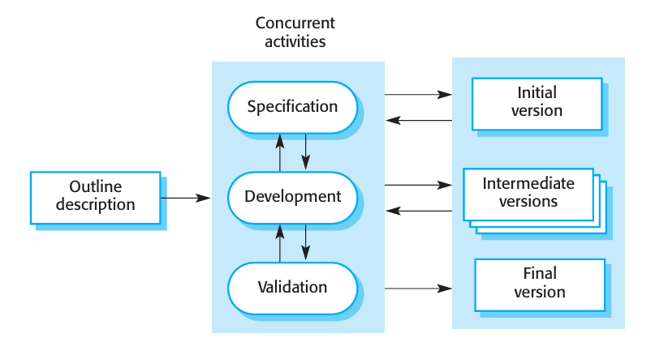
Incremental development

Slide 13
Incremental Model
Incremental development is based on the idea of developing an initial implementation, getting feedback from users and others, and evolving the software through several versions until the required system has been developed.
Specification, development, and validation activities are interleaved rather than separate, with rapid feedback across activities.

Slide 14
Incremental development benefits
The cost of accommodating changing customer requirements is reduced.
The amount of analysis and documentation that has to be redone is much less than is required with the waterfall model.
It is easier to get customer feedback on the development work that has been done.
Customers can comment on demonstrations of the software and see how much has been implemented.
More rapid delivery and deployment of useful software to the customer is possible.
Customers are able to use and gain value from the software earlier than is possible with a waterfall process.

Slide 15
Incremental development problems
The process is not visible.
Managers need regular deliverables to measure progress.
If systems are developed quickly, it is not cost-effective to produce documents that reflect every version of the system.
System structure tends to degrade as new increments are added.
Unless time and money is spent on refactoring to improve the software, regular change tends to corrupt its structure.
Incorporating further software changes becomes increasingly difficult and costly.

Slide 16
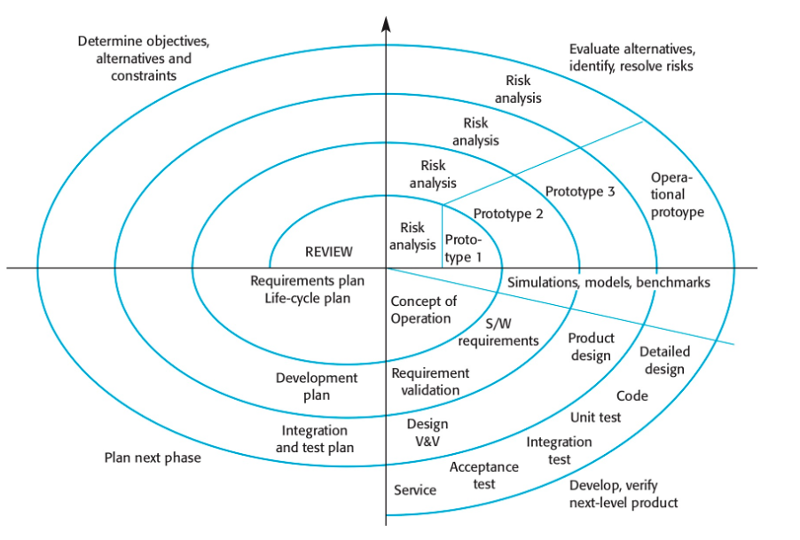
Spiral Model

Slide 17
Spiral Model
Barry Boehm (Boehm, 1988) proposed a risk-driven software process framework (the spiral model) that integrates risk management and incremental development.
The software process is represented as a spiral rather than a sequence of activities with some backtracking from one activity to another.
Each loop in the spiral represents a phase of the software process.
Thus, the innermost loop might be concerned with system feasibility, the next loop with requirements definition, the next loop with system design and so on.
The spiral model combines change avoidance with change tolerance. It assumes that changes are a result of project risks and includes explicit risk management activities to reduce these risk.

Slide 18
Spiral model sectors
Objective setting
Specific objectives for the phase are identified.
Risk assessment and reduction
Risks are assessed and activities put in place to reduce the key risks.
Development and validation
A development model for the system is chosen which can be any of the generic models.
Planning
The project is reviewed and the next phase of the spiral is planned.

Slide 19
Each loop in the spiral is split into four sectors:
Objective setting Specific objectives for that phase of the project are defined. Constraints on the process and the product are identified and a detailed management plan is drawn up. Project risks are identified. Alternative strategies, depending on these risks, may be planned.
Risk assessment and reduction For each of the identified project risks, a detailed analysis is carried out. Steps are taken to reduce the risk. For example, if there is a risk that the requirements are inappropriate, a prototype system may be developed.
Development and validation After risk evaluation, a development model for the system is chosen. For example, throw-away prototyping may be the best development approach if user interface risks are dominant. If safety risks are the main consideration, development based on formal transformations may be the most appropriate process, and so on. If the main identified risk is sub-system integration, the waterfall model may be the best development model to use.
Planning The project is reviewed and a decision made whether to continue with a further loop of the spiral. If it is decided to continue, plans are drawn up for the next phase of the project.

Slide 20
Advantages of Spiral Model
High amount of risk analysis hence, avoidance of Risk is enhanced.
Good for large and mission-critical projects.
Strong approval and documentation control.
Additional Functionality can be added at a later date.
Software is produced early in the software life cycle.

Slide 21
Disadvantages of Spiral Model
Can be a costly model to use.
Risk analysis requires highly specific expertise.
Project’s success is highly dependent on the risk analysis phase.
Doesn’t work well for smaller projects.

Slide 22
When to use Spiral model:
When costs and risk evaluation is important
For medium to high-risk projects
Long-term project commitment unwise because of potential changes to economic priorities
Users are unsure of their needs
Requirements are complex
New product line
Significant changes are expected (research and exploration)

Slide 23
Real-World Examples of Spiral Model Implementation
The following are where programmers use the Spiral Model.
Developing large-scale gaming applications.
Developing electronic health record systems in the healthcare industry.
In the e-commerce platforms for incorporating new features or improving existing ones without compromising system stability or security.
Development of mobile applications.

Slide 24
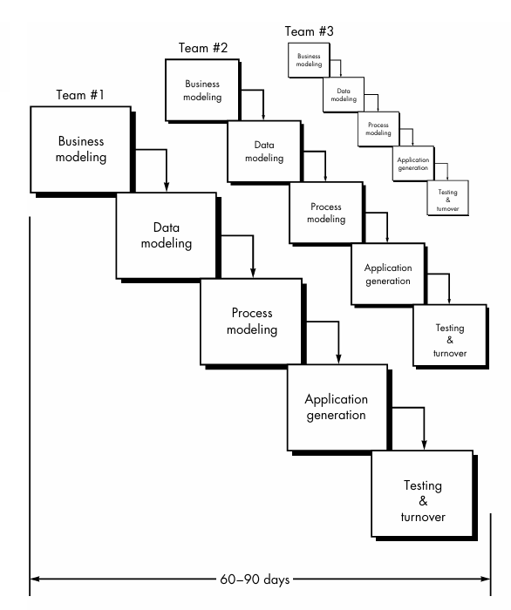
Rapid Application Development (RAD) Model

Slide 25
RAD Model
Rapid application development (RAD) is an incremental software development process model that emphasizes an extremely short development cycle.
The RAD model is a “high-speed” adaptation of the linear sequential model in which rapid development is achieved by using component-based construction.
If requirements are well under stood and project scope is constrained, the RAD process enables a development team to create a “fully functional system” within very short time periods (e.g., 60 to 90 days).

Slide 26
Phases of RAD Model
1. Business modeling. The information flow among business functions is modeled in a way that answers the following questions: What information drives the business process? What information is generated? Who generates it? Where does the information go? Who processes it?
2. Data modeling. The information flow defined as part of the business modeling phase is refined into a set of data objects that are needed to support the business. The characteristics (called attributes) of each object are identified and the relationships between these objects defined.

Slide 27
3. Process modeling. The data objects defined in the data modeling phase are transformed to achieve the information flow necessary to implement a business function. Processing descriptions are created for adding, modifying, deleting, or retrieving a data object.
4. Application generation. Rather than creating software using conventional third generation programming languages the RAD process works to reuse existing program components (when possible) or create reusable components (when necessary). In all cases, automated tools are used to facilitate construction of the software.
5.Testing and turnover. Since the RAD process emphasizes reuse, many of the program components have already been tested. This reduces overall testing time. However, new components must be tested and all interfaces must be fully exercised.

Slide 28
Disadvantages
RAD requires sufficient human resources to create the right number of RAD teams.
RAD requires developers and customers who are committed to the rapid-fire activities necessary to get a system complete in a much abbreviated time frame.
Not all types of applications are appropriate for RAD. If a system cannot be properly modularized, building the components necessary for RAD will be problematic.
RAD is not appropriate when technical risks are high.

Slide 29
Real-life examples of RAD
Examples of scenarios where the RAD model in software engineering could be used:
Mobile App Development
E-Commerce Platform
Event Management System
Health Care Information System
Online Learning Platform etc.

Slide 30
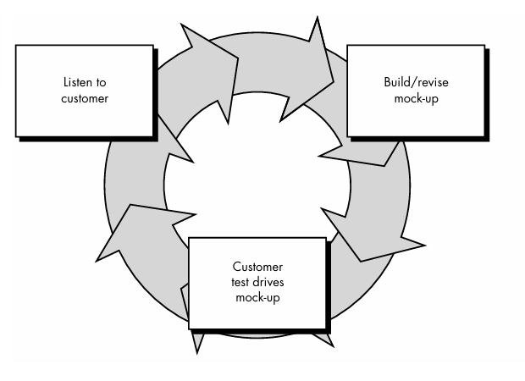
THE PROTOTYPING MODEL

Slide 31
THE PROTOTYPING MODEL
A customer defines a set of general objectives for software but does not identify detailed input, processing, or output requirements.
The prototyping begins with requirements gathering.
Developer and customer meet and define the overall objectives for the software, identify whatever requirements are known, and outline areas where further definition is mandatory.
A "quick design" then occurs. The quick design focuses on a representation of those aspects of the software that will be visible to the customer/user. The quick design leads to the construction of a prototype.

Slide 32
The prototype is evaluated by the customer/user and used to refine requirements for the software to be developed.
Iteration occurs as the prototype is tuned to satisfy the needs of the customer, while at the same time enabling the developer to better understand what needs to be done.

Slide 33
Where is the prototype model of software development well suited?
The answer is when a customer cannot define requirements clearly and when the user is ready to be actively involved and can provide feedback.
Example
Online systems and web interfaces typically involve a high degree of end-user interaction and are best suited for prototype models.
A shopping website is also an example where a prototyping approach can be implemented. You can develop various web page prototypes for shopping pages, such as catalog pages, product order pages, etc., and submit them to customers for approval.

Slide 34
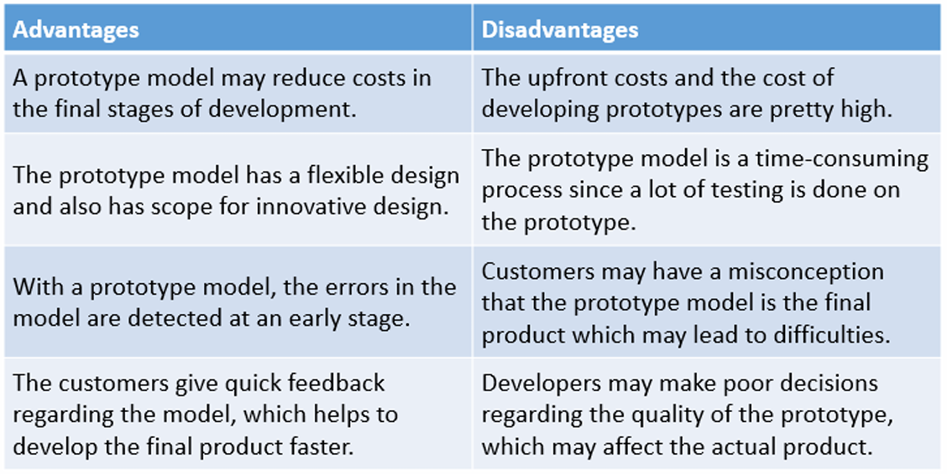
Advantages and Disadvantages of Prototype Model

